Slide 1
Chapter 2: Legacy system Analysis
Software Re-engineering - Undergraduate Course

Slide 2
Legacy Systems Overview
A legacy system is an old or outdated computer system, software, or technology that is still in use, even though newer alternatives exist.
They may still meet critical business needs.
Often difficult and costly to replace or integrate with modern systems.

Slide 3
What Are Legacy Systems?
Older software/hardware still in use
Critical for business operations
Difficult to modify or extend

Slide 4
Key Characteristics
Old Technology – built with outdated programming languages, hardware, or databases (e.g., COBOL, mainframes).
Business Critical – continues to support essential operations.
Hard to Maintain – poor documentation, lack of skilled personnel, and technical debt.
Integration Issues – limited ability to connect with modern systems and APIs.
High Risk – more prone to failures, bugs, and security vulnerabilities.
Notes:
Technical debt (also known as design debt or code debt) is a qualitative description of the cost to maintain a system that is attributable to choosing an expedient solution for its development.
An API (Application Programming Interface) is a set of rules and protocols that allows different software applications to communicate with each other by exchanging data, features, and functionality.

Slide 5
Components of a Legacy System
Software – the application programs (e.g., payroll system in COBOL).
Data – critical business records stored in old formats.
Hardware – outdated machines (e.g., mainframes).
Processes – business procedures tied to the system’s functionality.
People – users and maintainers with knowledge of the system.

Slide 6
Options for Dealing with Legacy Systems
Continued Maintenance – patch and keep running.
Wrapping – add interfaces/APIs to connect with modern systems.
Migration – move to modern platforms/languages.
Replacement – build or purchase a new system.
Re-engineering – restructure and modernize the existing system.

Slide 7
Legacy vs Modern Architecture
Legacy: Mainframe + Terminals
Modern: Web + Cloud + Mobile

Slide 8
Case Study - University Management System (Before)
COBOL-based system
Manual processes
High costs

Slide 9
Case Study - Transition Process
Step 1: Analysis
Step 2: Reverse Engineering
Step 3: Redesign in Java
Step 4: Deploy new system

Slide 10
Case Study - University Management System (After)
Java-based web system
Online access
Scalable and user-friendly

Slide 11
Case Study - Outcomes
Improved usability
Reduced costs
Greater scalability
Notes:
scalability is the ability of a system to handle an increasing amount of work, users, or data without breaking down, while maintaining performance.

Slide 12
Business Value of Legacy Systems
Even though legacy systems may use outdated technologies, they often remain critical because of the following values:
1. Core Business Operations
Legacy systems often run the main daily processes (banking transactions, airline booking, hospital patient records).
Without them, the business might not function.
2. High Investment Already Made
Organizations have spent years of money, resources, and expertise in developing and customizing them.
Replacing them entirely would be very costly and risky.

Slide 13
3. Embedded Business Knowledge
Legacy systems store decades of organizational knowledge in their rules, workflows, and data.
Example: An insurance system may contain rare actuarial calculations refined over 30 years.
4. Stability and Reliability
Legacy systems, though old, are often highly stable (tested over years).
Example: Mainframes in banks process billions of transactions reliably.
Notes:
"Actuarial" refers to actuarial science, a discipline that uses mathematical and statistical methods to assess and manage risk and uncertainty for organizations and individuals.

Slide 14
5. Regulatory and Compliance Value
Many legacy systems are tailored to meet specific government and industry regulations.
Replacing them could risk non-compliance.
6. Integration with Other Systems
Legacy systems often serve as the central hub that other systems depend on.
Example: A hospital legacy system connects labs, pharmacies, and billing.
7. Customer and Market Trust
Clients and customers trust systems that have proven reliable over decades.
Abrupt changes can risk customer dissatisfaction.
Notes:
Tailored=custom-made
Abrupt =sudden

Slide 15
Legacy system Analysis Approaches
Before migrating, re-engineering, or replacing a legacy system, organizations must first analyze it. Several analysis approaches are commonly used:
Business process analysis
Data analysis
Code analysis
Architecture analysis
User/Stakeholder Interviews
Performance and Usage Analysis

Slide 16
1. Business Process Analysis
Focus: Understand what the system does in terms of business operations.
Goal: Identify which processes are critical, outdated, or redundant.
Example: An insurance system’s claims-processing workflow is analyzed to see if it matches current practices.

Slide 17
2. Data Analysis
Focus: Examine data structures, files, and databases inside the system.
Goal: Identify data quality issues, redundancies, and opportunities for migration.
Example: An old mainframe system with customer data is analyzed before migrating to a modern relational DB.
Notes:
A relational database is a type of database that stores and organizes data in a structured format using tables, rows, and columns. It is based on the relational model of data, proposed by E. F. Codd in 1970.

Slide 18
3. Code Analysis
Focus: Review source code, modules, and dependencies.
Goal: Assess complexity, maintainability, and hidden business rules.
Techniques: Static analysis, cyclomatic complexity, code metrics.
Example: COBOL banking software is analyzed to identify modules for re-engineering.
Notes:
Business rules are explicit statements that define and constrain a business's behavior, acting as guiding principles for decisions and processes to ensure consistency, compliance, and efficiency.
Code metrics are measurements and quantifiable indicators used to assess the quality, complexity, and maintainability of software code. They help developers identify potential issues like code smells, complex areas needing refactoring, and areas that may hinder long-term reliability. Common code metrics include lines of code, cyclomatic complexity, depth of inheritance, and class coupling, with tools like Visual Studio providing built-in analysis capabilities.

Slide 19
4. Architecture Analysis
Focus: Study the system’s structure (components, interfaces, dependencies).
Goal: Understand how parts interact and where bottlenecks or risks exist.
Example: Layered diagram of a legacy payroll system shows tightly coupled modules.

Slide 20
5. User/Stakeholder Interviews
Focus: Collect insights from end-users, admins, and managers.
Goal: Identify pain points, workarounds, and unmet needs.
Example: Hospital staff reveal that the old patient system requires manual duplicate entries.
Notes:
A "pain point" is a problem, challenge, or frustration experienced by a consumer, customer, or employee that causes annoyance, distress, or inefficiency.
Workaround is a a method for overcoming a problem or limitation in a program or system.

Slide 21
6. Performance and Usage Analysis
Focus: Measure system performance, workloads, response times.
Goal: Identify bottlenecks and determine whether the system meets current needs.
Example: Airline booking system analysis shows peak-time slowdowns.

Slide 22
Legacy System Assessment - Overview
Legacy system assessment is the process of evaluating the business, technical, and operational value of an existing system to determine its future role in the organization.
Frameworks help decide whether to maintain, replace, or re-engineer

Slide 23
Key Dimensions of Assessment
1. Business Value
Does the system support critical business functions?
Does it provide competitive advantage?
Does it comply with regulations?
Rating: High, Medium, Low

Slide 24
2. System Quality
How reliable, maintainable, and secure is the system?
What is the level of technical debt?
Is the system well-documented?
Rating: High, Medium, Low

Slide 25
3. Cost of Ownership
What are the maintenance costs (staff, licensing, infrastructure)?
Is vendor support available?
Is the hardware/software obsolete?
Rating: Expensive, Moderate, Low
4. Risk Factors
What risks are associated with keeping it? (e.g., security vulnerabilities, skill shortages, compliance risk)
What risks are associated with replacing it? (e.g., migration failures, cost overruns)
Notes:
Infrastructure is the basic physical and organizational structures and facilities (e.g. buildings, roads, power supplies) needed for the operation of a society or enterprise.
A vendor is an individual, company, or other entity that sells goods or services to another party for payment

Slide 26
Assessment Outcomes
Based on these evaluations, systems are typically categorized as:
Retain – Keep running with minimal changes.
Encapsulate – Wrap with APIs for integration while leaving core untouched.
Re-engineer – Refactor, modularize, or modernize code.
Migrate – Move to new platforms (e.g., cloud).
Replace – Develop or buy a new system.
Notes:
Hide internal implementation details of a system or module, and expose only necessary functionality through a well-defined API (interface).
Real-World Example
Operating Systems: File APIs (you don’t touch disk sectors directly).
Cloud Platforms: AWS, Azure — everything through APIs.
Microservices: Each service encapsulates its logic and exposes REST or GraphQL APIs.

Slide 27
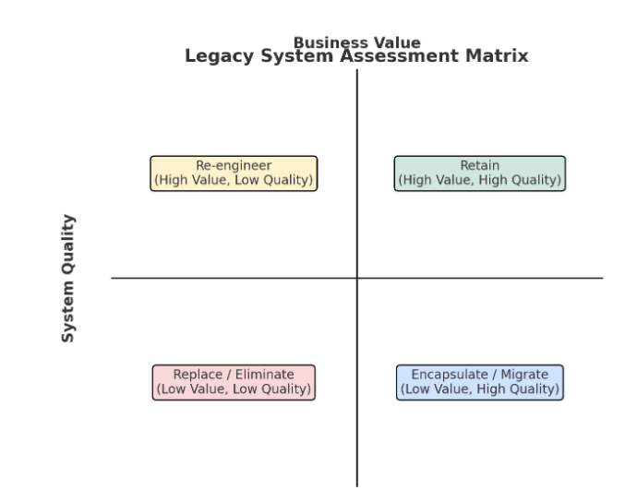
Legacy System Assessment Matrix

Slide 28
Case Study: Bank Mainframe Core Banking System
Background
A large bank has been using a COBOL-based mainframe core banking system for 35 years. The system manages customer accounts, loans, and transactions, but maintenance costs are rising and few developers know COBOL.
Assessment Using the Matrix
1. Business Value
The system handles all core banking operations → Very High Value.
Customers depend on it for daily financial services.
✅ Rating: High

Slide 29
2. System Quality
Code: Old COBOL, poorly documented, complex.
Performance: Stable, but hard to scale.
Maintenance: Expensive (shortage of COBOL experts).
Security: Lacks modern safeguards.
❌ Rating: Low
Matrix Placement
High Business Value + Low System Quality → Re-engineer.

Slide 30
Decision
The bank decides to re-engineer the mainframe system:
Encapsulate with APIs for short-term digital banking integration.
Gradually migrate to a modern cloud-based microservices architecture.
Retain business rules but rewrite in modern languages (Java/Python).
This assessment helps the bank:
Avoid unnecessary full replacement (too risky & costly).
Preserve valuable business logic.
Improve maintainability and scalability over time.
Notes:
A microservices architecture is a way of building applications as a collection of small, independent services — each responsible for a specific business function.
When deployed in the cloud, these services can scale automatically, communicate over APIs, and run independently on containers or serverless platforms.
Instead of one big application (monolith), you have many small apps (microservices) that work together in the cloud.

Slide 31
Case Study - Airline Reservation System (Background)
Developed in 1970s
Critical for daily operations
Built with COBOL on mainframes

Slide 32
Case Study - Challenges
Integration with web and mobile platforms
High maintenance costs
Shortage of COBOL programmers

Slide 33
Case Study - Analysis Results
High business value
Low technical quality
Critical need for modernization

Slide 34
Case Study - Solution
Re-engineered using service-oriented architecture
Exposed core functions as APIs
Enabled web and mobile access
Notes:
Service-Oriented Architecture (SOA) is a software design style where the system is organized into a collection of services — each providing a specific business function and communicating through standardized interfaces (often over a network).
SOA breaks large software systems into loosely coupled services that interact via well-defined protocols.

Slide 35
Case Study - Outcomes
Improved scalability
Reduced maintenance costs
Extended system life

